Slide 1
Ensamble methods
Stacking: Neural Net with models + data as inputs, assigns weights to each model
Bagging
Boosting
Voting/EM

Slide 2
Models
  XGBoost/CatBoost
  DeepPyhsNet (requires coordinates, understanding physics)
  ClimaX (Microsoft)
  Correction NN

Slide 3
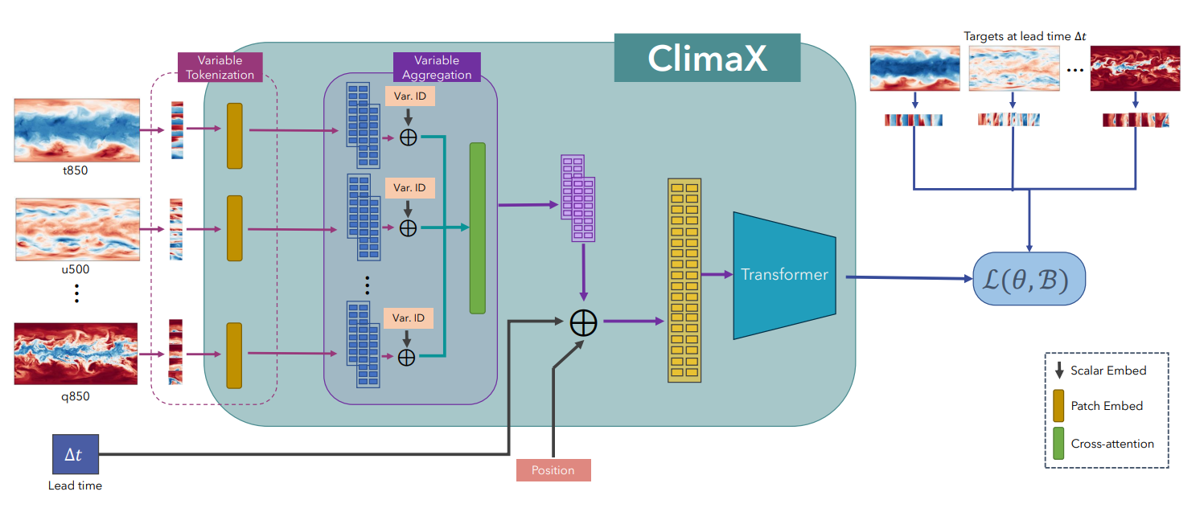

Slide 4
